Slide 1

Go-to-Market(G2M) Strategy
Presenter: Taimoor Razi
Date: 20-07-2022
Notes:
Hello and welcome, my name is Taimoor Razi and today I will be presenting to you the results of the Data Glacier Team on our clients Go-to-Market(G2M) strategy.

Slide 2
Outline
Executive Summary
Problem Statement
Approach
Data Overview
Exploratory Data Analysis (EDA)
EDA Summary
Recommendations
Notes:
Today’s outline will be as follows:
1. We will give the executive summary and describe the problem statement of the project to give a high level understanding of the business problem we're tackling and the specific requirements.
2. I will then go over the approach that we followed to complete this task, so that you have complete clarity in how we tackle these kinds of tasks.
3. Finally, I will go over the Data Analysis we performed and all important results and I will present them as a series of insights and visualizations from our analysis.
4. To wrap up, I will summarize and give recommendations and will be open for any questions on behalf of our team.

Slide 3

XYZ is a private equity firm in US. Due to remarkable growth in the Cab Industry in last few years and multiple key players in the market, it is planning for an investment in Cab industry.
Executive Summary
XYZ understanding of the market is limited and they asked us, the Data Glacier team, to help them understand where to invest in the industry.
Notes:
To kick things off let me recap this engagement.
XYZ is a private equity firm in US. Due to remarkable growth in the Cab Industry in last few years and multiple key players in the market, it is planning for an investment in Cab industry.
We, Data Glacier are here to help you understand the market and guide you in the right direction.

Slide 4
Data Glacier Objective : Provide actionable insights to help XYZ firm in identifying the right company for making investment.
Data Glacier did a 3 month pilot focusing on these tasks:
Data Intake Report
EDA Notebook
Presentation to XYZ’s Executive team (Today)
Problem Statement
Notes:
Our Objective was to provide actionable insights to help XYZ firm in identifying the right company for making investment.
So, we embarked on a 1 month pilot with XYZ company to focus on 3 main tasks.
Data Intake Report
EDA Notebook
Presentation to XYZ’s Executive team which we are here today to present

Slide 5


1
Data Understanding
Approach
2
Data Extraction
3
Data Cleaning/Modelling
4
Exploratory Data Analysis
5
Recommendations
Notes:
So, how did we tackle this problem?
Well we approached it in 5 steps:
1. Data understanding - the key to success on any data project is to understand the data in detail. So we took the time to understand the data model and domain of the business you are interested in.
2. Data extraction - after understanding your business, we then architected what an ideal dataset should look like for this problem and extracted it from the relevant data sources.
3. After extracting the raw data, we needed to process and model this data into a dataset that can precisely answer the business questions and produce analytics.
4. With our new dataset, we used our analytical expertise to uncover insights from this dataset and to produce visualizations to describe the insights.
5. And finally we used these insights to unlock business decisions and to make recommendations on next steps.

Slide 6
Cab_Data.csv
Data Overview
Transaction_ID.csv
Final Cab Data
Customer_ID.csv
City.csv
Notes:
Lets make a quick Data overview. Since today we are here to focus on the analysis and insight, I will quickly go through the Data Overview.
After understanding the data needed for us to make the Analysis we extracted 4 different datasets from different sources. The final dataset was made by merging all these datasets into one final Dataset which was used to perform analysis. The details of how the dataset was merged can be find in both data intake report and EDA notebook.

Slide 7
Final Cab Data
14 Features
Data Overview
359392 data points
2016-01-31 to 2018-12-31
New features (profit, year, month)
Notes:
The resulted dataset had 14 features i.e., columns and 359392 data points i.e., rows. All this data is between the period 2016-01 to 2018-12-31. Also note that in addition to our original 14 features we created some new features to help with out analysis. These features include year, month and profit. The profit was calculated by subtracting the price charged to the customer minus the cost of the trip.

Slide 8
The Exploratory Data Analysis (EDA) has been divided into four parts:
Market Overview: Categorical and Numerical Variable Analysis
Demand Analysis
Profit Analysis
Customer Loyalty Analysis
Exploratory Data Analysis (EDA)
Notes:
Now to the most important of the day, EDA. We divided the EDA into 4 parts. First we did a market overview by doing a categorical and numerical variable analysis. Then we did demand and profit analysis to compare the companies on these basis. Finally, we did a customer loyalty analysis to see which company the customers are most loyal to.

Slide 9
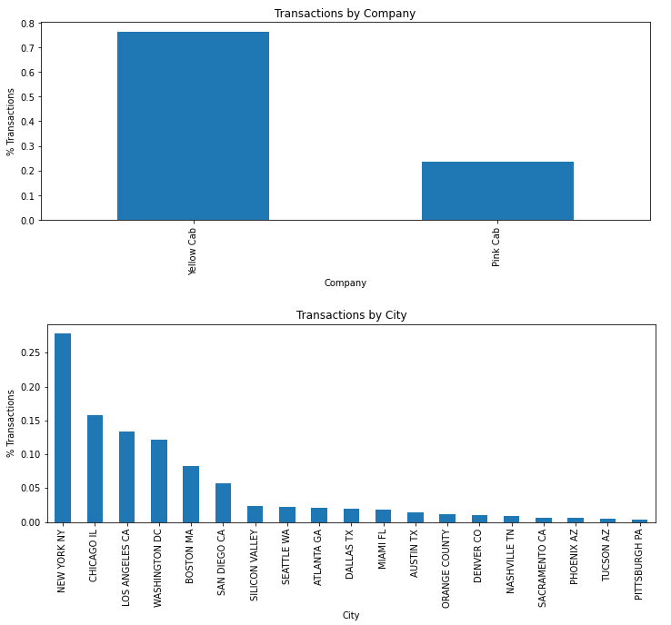
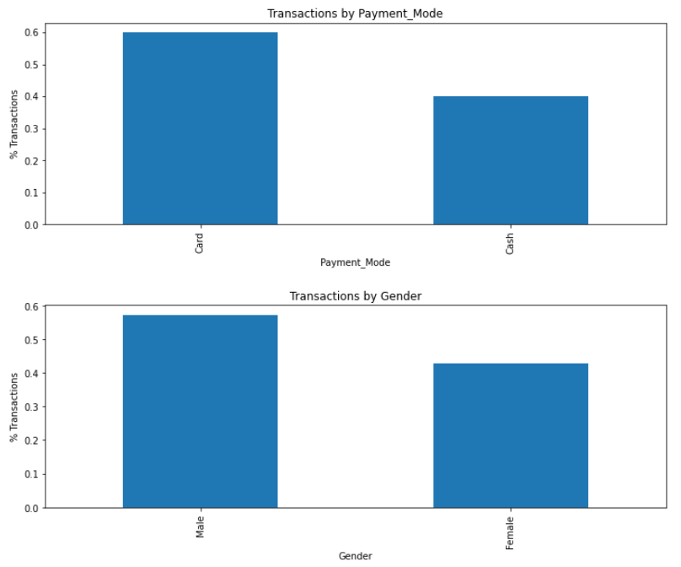
Market Overview – Categorical Variable Analysis
Notes:
There are some points to be noted from the categorical variables
1. There are two cab companies in the market. Yellow cab has much more transactions than pink cab in the whole period (ratio of 3:1).
2. The highest number of transactions happened in new york followed by chicago.
3. 60% of transactions happen through the card compared to 40% by cash.
4. Around 57.3% of transactions are carried by men compared to 42.7% by women.

Slide 10
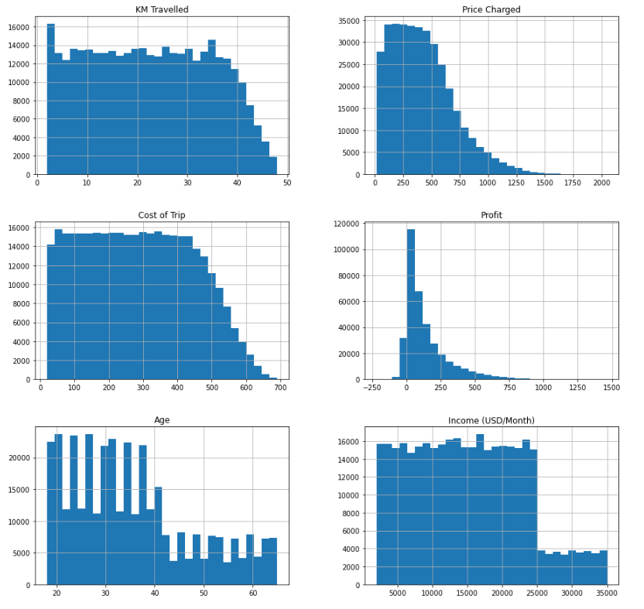
Market Overview – Numerical Variable Analysis
Notes:
There are some points to be noted from the continuous variables
1. The maximum distance travelled by any passenger within all transactions is 48 km. There is a spike in transactions for the short distances under 5 km. The number of people travelling distances longer than 35 km decreases rapidly.
2. The number of transactions being charged more than 500 usd decreases rapidly. This makes sense as less people are travelling very long diistanecs as well. cost of trip also follows a similar trajectory.
3. The number of transactions with high profit margins decreases. There are some losses as well.
4. Most of the transactions are being done by relatively younger people. The number of transactions decreases for people older than 40 years old.
5. People with incomes greater than 25000 have much lower transactions.

Slide 11
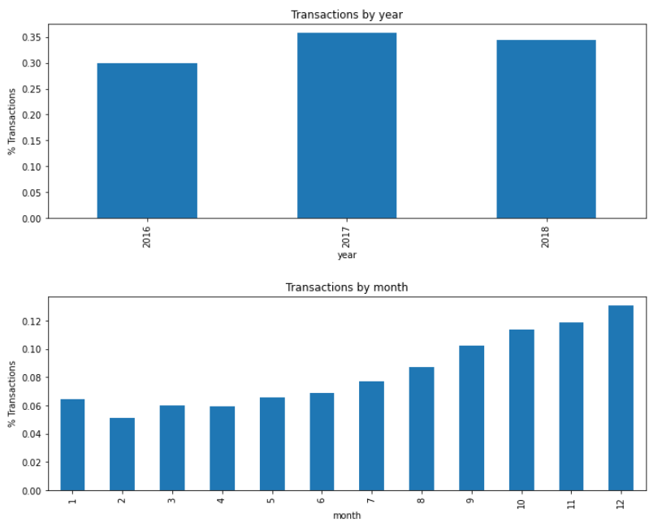
Market Overview – Numerical Variable Analysis
Notes:
Notes:
1. The most number of transactions happened in 2017 followed by 2018 and then 2016. However also not that we do not have the data of Janauary of 2016.
2. For the whole period (3 years), more transactions happened in the ending-year months i.e., september-december.

Slide 12
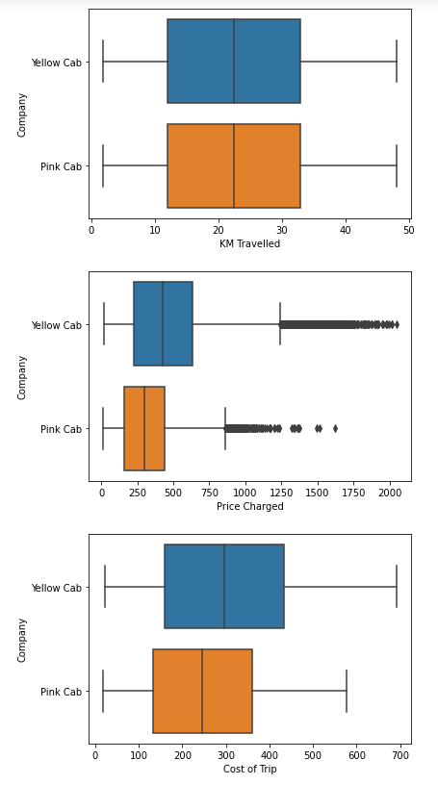
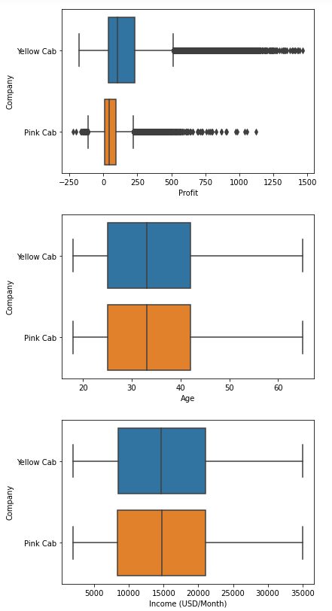
Market Overview – Pink cab vs Yellow cab
Notes:
Points to be noted:
1. No difference between both companies when it comes to KM travelled by the passengers.
2. Yellow cab charged more price, have higher cost and higher profit than Pink cab. This will be investigated further in Profit(loss) Analysis section.
3. There is no difference in the ages and income of the people who choses these two cabs.
4. There are negative profit values which means there are losses incurred by the cabs for some transactions. We will go into detail later in Profit(loss) Analysis Section.

Slide 13
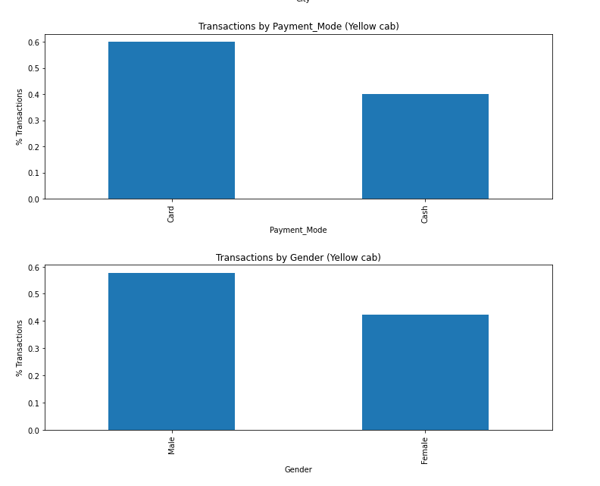
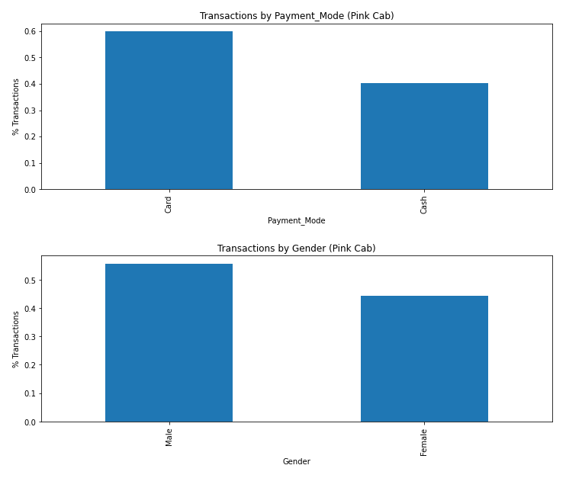
Market Overview – Pink cab vs Yellow cab
Notes:
There is no difference between two cab companies when it comes to gender or payment mode.

Slide 14
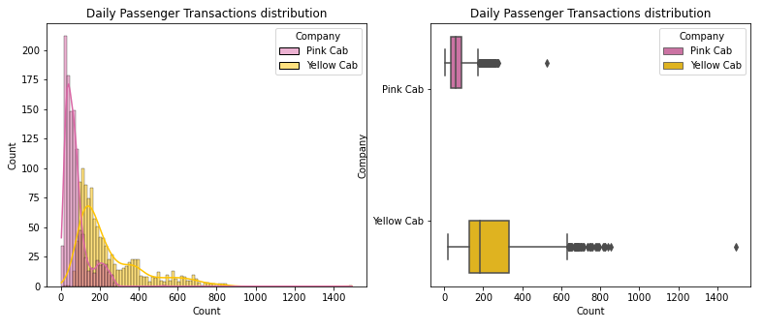
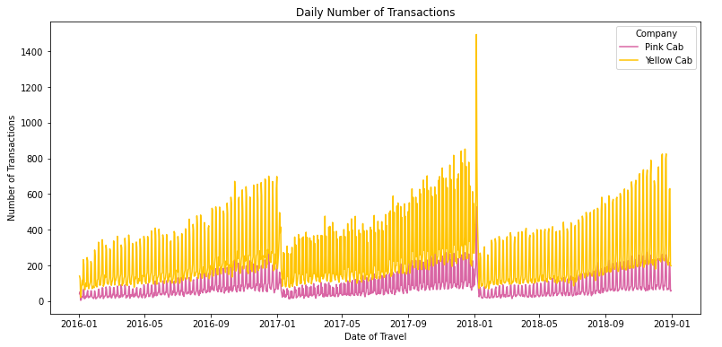
Demand Analysis – Daily Demand
Notes:
The graph shows the daily transactions made by yellow and pink cab for the whole period. There is a clear seasonality for both companies and they follow similar pattern.
There is a clear upward trend on monthly level. On new year, the daily transactions dips down to the lowest again. But on a yearly level, the trend seems to be almost uniform.
Yellow Cab makes a lot more transaction on any given day compared to Pink Cab
The highest reported trips for both Cab companies was on 5th of January, 2018 which is shown by the huge spike on the graph. This rise in demand was due to the snow not being cleared on time in New York after the snow storm which lead to bus stops being blocked by snow affecting the public transportation.

Slide 15
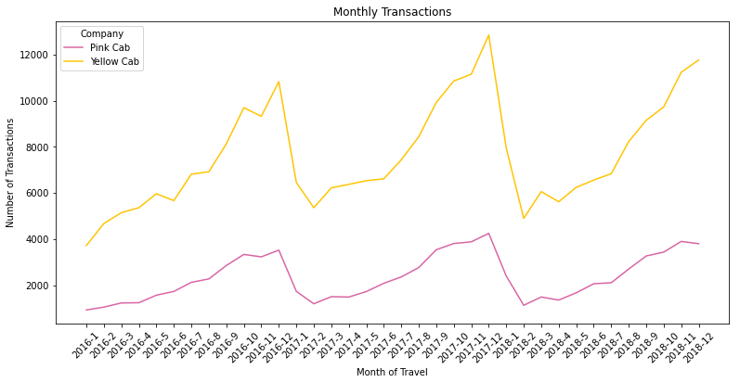
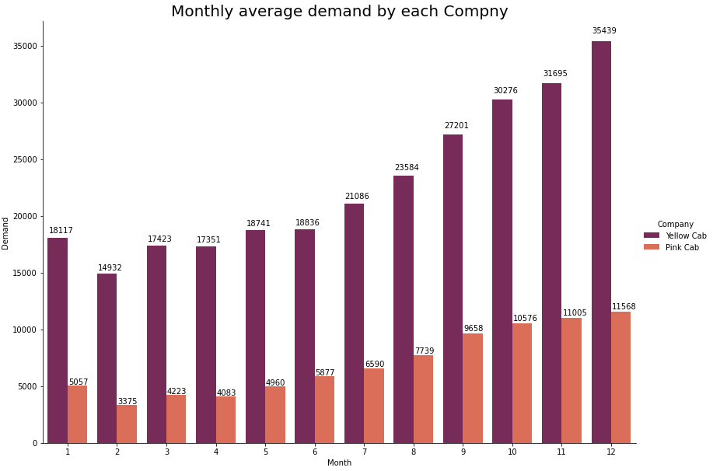
Demand Analysis – Monthly Demand
Notes:
We can clearly see that there is a seasonality from the monthly analysis. The number of transactions at the month of February is the lowest and the number of transactions at the month of December is the highest for all the years. For both Cab companies, there is a slight upward trend throughout the years.

Slide 16
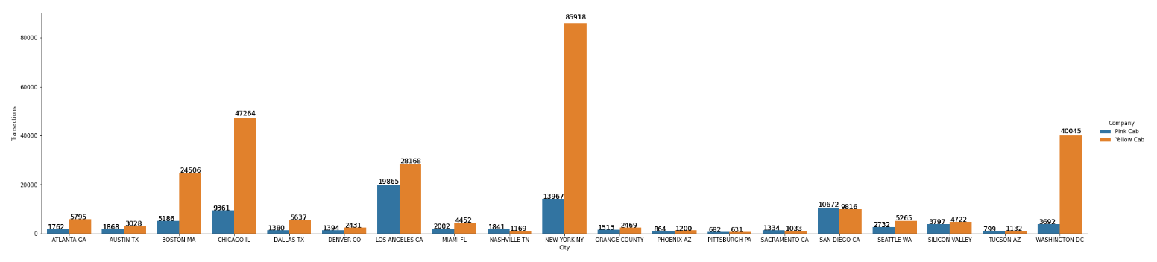
Demand Analysis – Demand by City
Notes:
Pitsburgh, San Diego, Sacremento and Nashville are the only 4 places where pink cab has more transactions over the period than yellow cab. All the other cities, yellow cab has the majority.

Slide 17
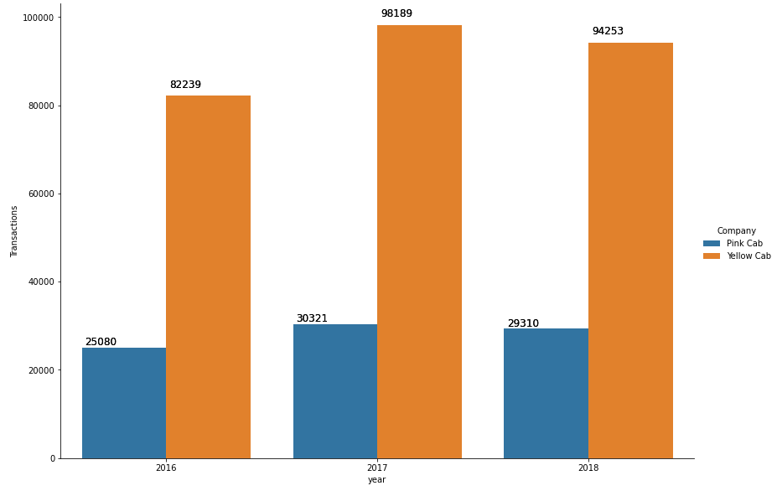
Demand Analysis – Yearly Demand
Notes:
2016 has a little lower transactions than 2017 and 2018 for both companies. This can be explained by the fact that the data provided does not take into account January,2016 transactions.
There is a small decrease in transactions from 2017 to 2018.

Slide 18
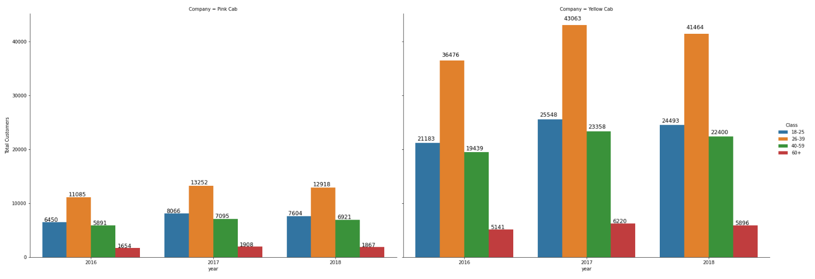
Demand Analysis –By Age Group
Notes:
We can see the same pattern for both the companies.
26-39 years old age group taking the most cabs in all 3 years and the senior citizens taking the least.

Slide 19
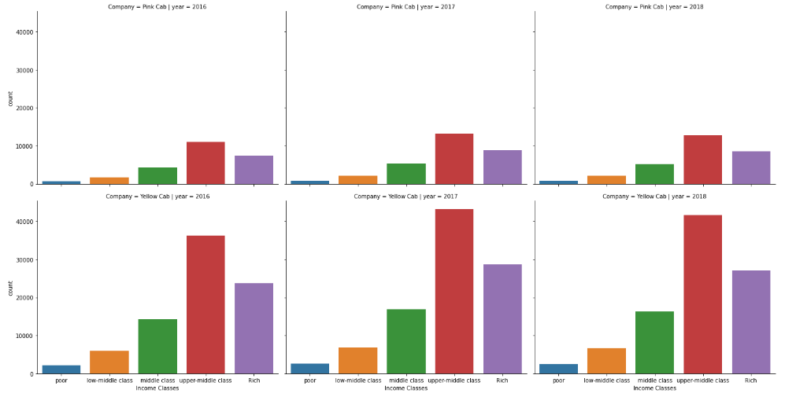
Demand Analysis –By Customer Income
Notes:
More detailed analysis shows that the people take more cabs if they get wealthy up to a certain point. If they fall into the rich class they tend to take less cab (probably buy their own car).

Slide 20
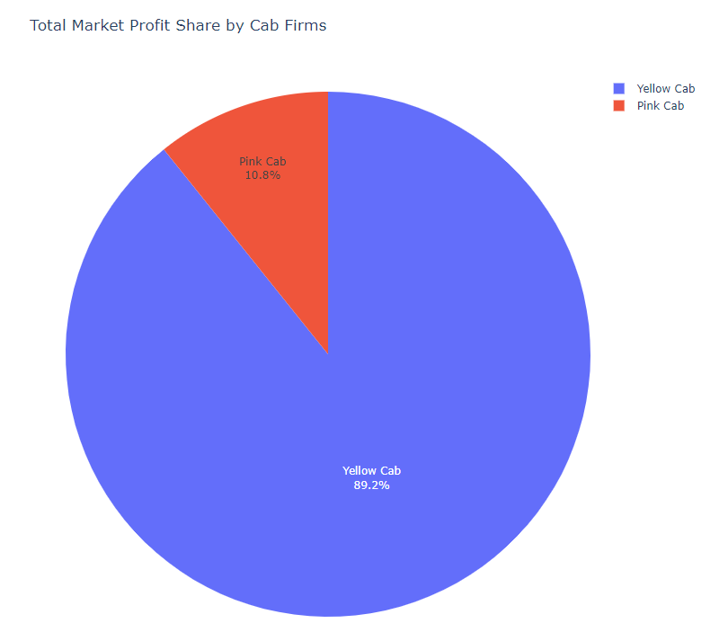
Profit Analysis –Market Profit Share by Cab Company
Notes:
Yellow cab is making almost 8 times more profits than pink cab over the whole period.

Slide 21
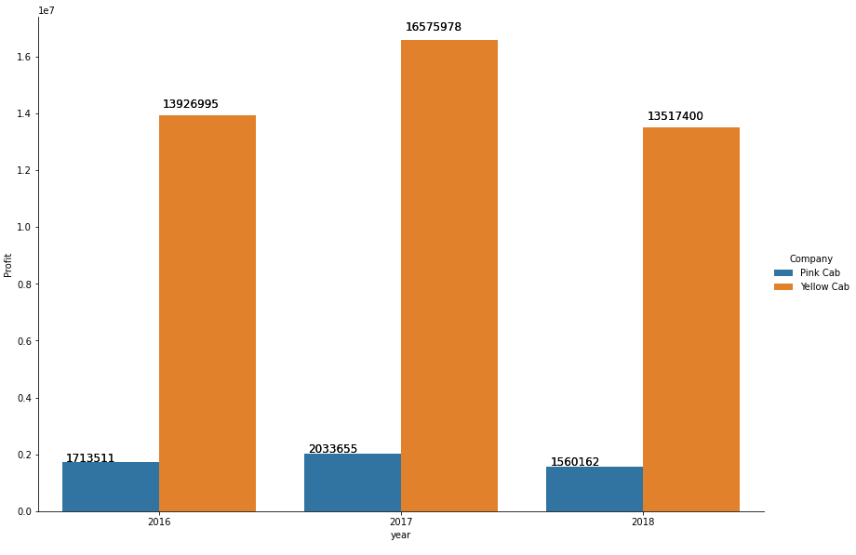
Profit Analysis –Annually
Notes:
Yellow cab is making almost 8 times more profits than pink cab every year

Slide 22
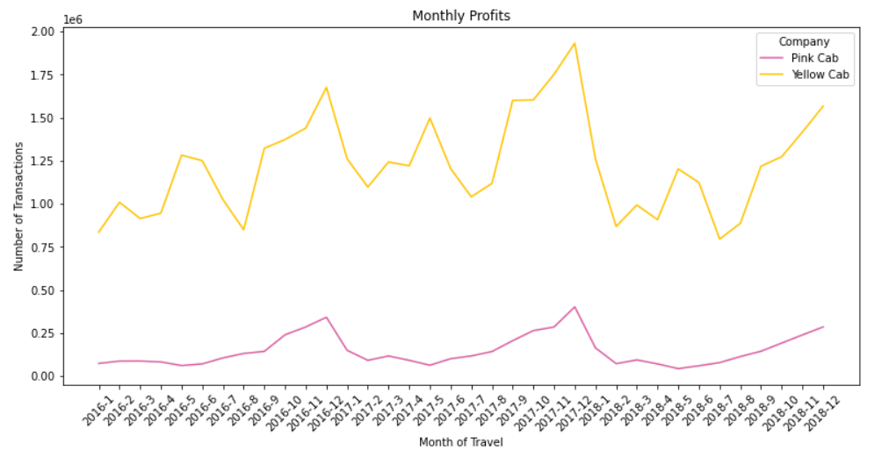
Profit Analysis –Monthly Time Series

Slide 23
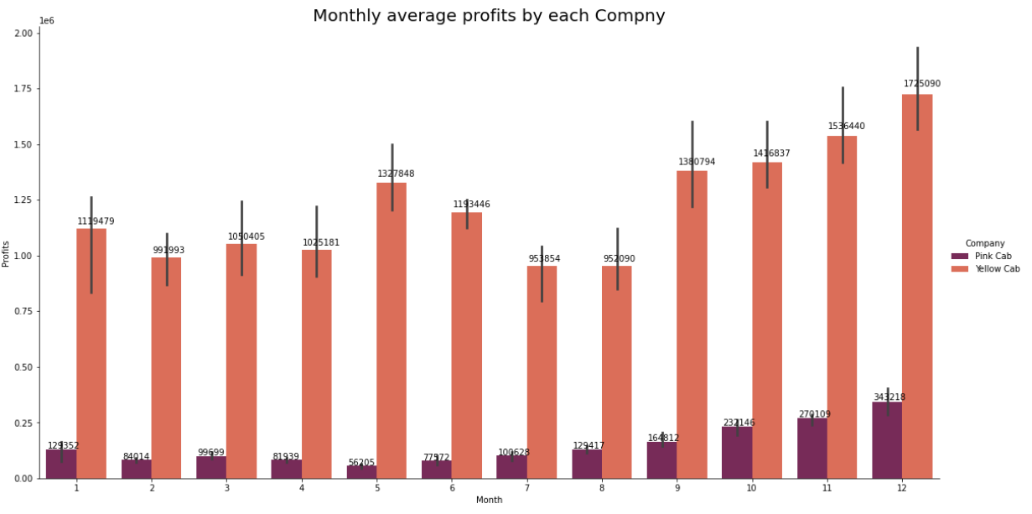
Profit Analysis –Monthly Average
Notes:
For both cab companies, December is the most profitable month of the year.

Slide 24
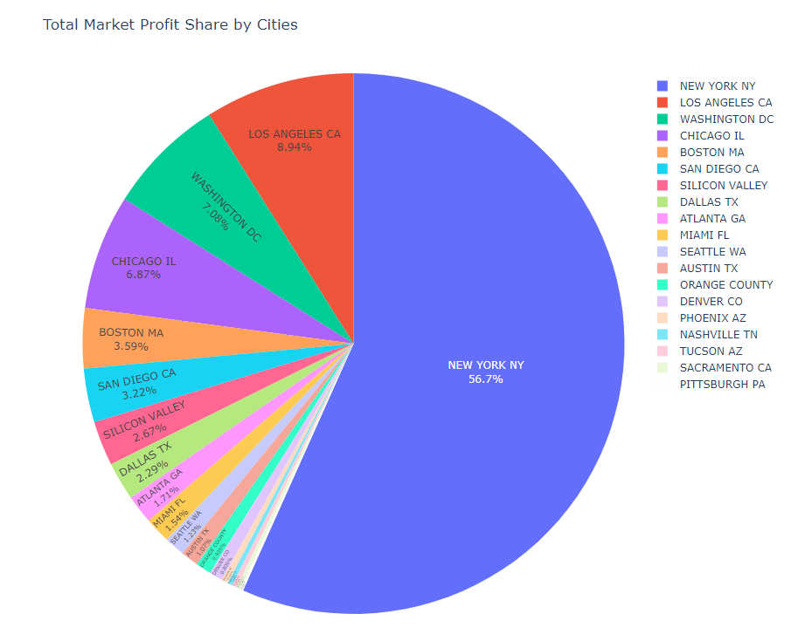
Profit Analysis –Monthly by City

Slide 25
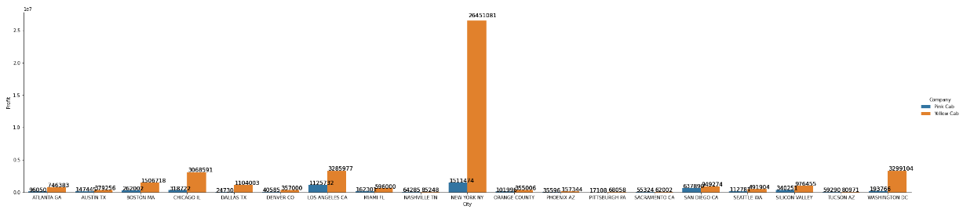
Profit Analysis –Monthly by City
Notes:
For both cab companies, NY is the most profitable city for business

Slide 26
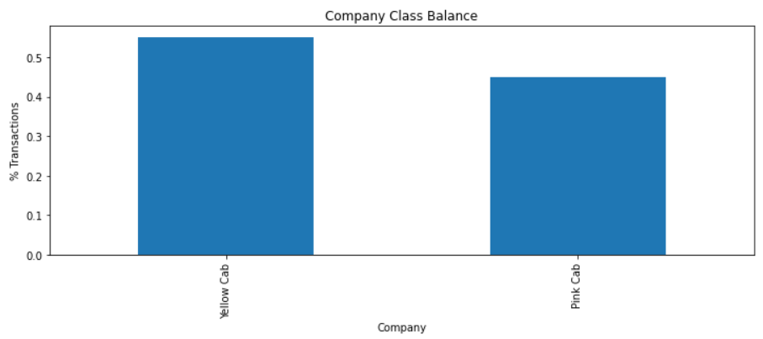
Profit Analysis – Loss Comparison
Notes:
Although Yellow cab carry 3 times more overall transactions than pink cab, it only carried a little more loss transactions than pink cab. This shows that pink cab has a greater loss transaction ratio than yellow cab.

Slide 27
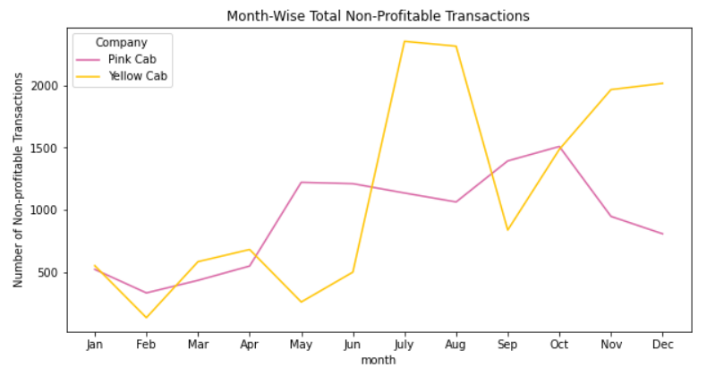
Profit Analysis – Loss Comparison by months
Notes:
July and August are the months where the most losses occurred for yellow cab. For pink cab May-October has incurred the most losses.

Slide 28
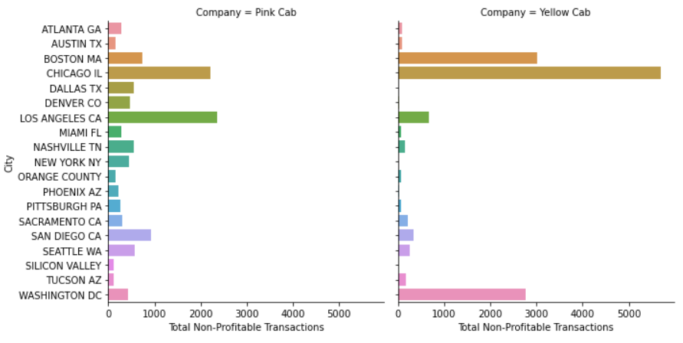
Profit Analysis – Loss Comparison by city
Notes:
For yellow cab, Los Angeles, Washington, Chicago and Boston is incurring the most losses.
For pink cab, most of the cities are incurring frequent losses. However, the most transactions with losses are at Los Angeles, Chicago, San Diego and Boston.

Slide 29
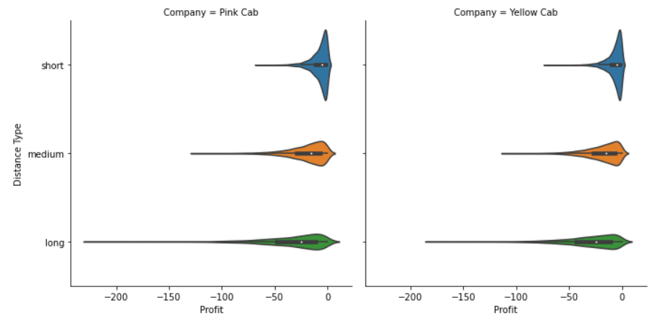
Profit Analysis – By Distance Travelled (Km)
Notes:
For both Cab companies, short trips results in higher frequency of losses. Losses made during medium trips are roughly the same for both. For long trips, although the frequency is less compared to other two intervals, there is a small probability to make higher losses.
Pink Cab
Pink cab has trips with the highest losses compared to it's rival.

Slide 30
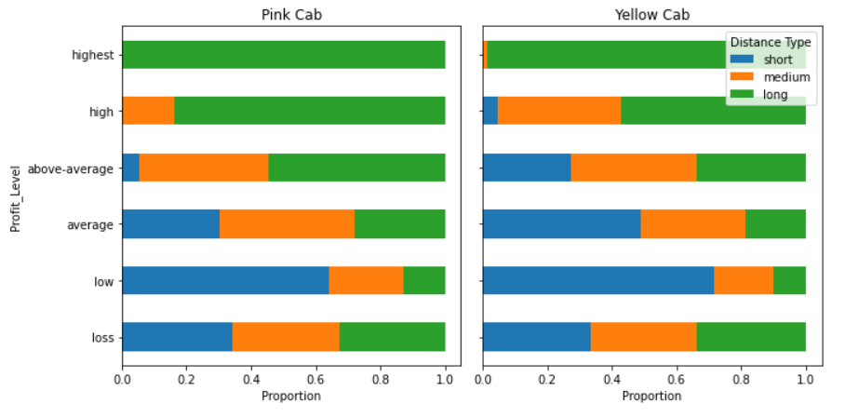
Profit Analysis – By Distance Travelled (Km)
Notes:
The highest profits are almost always made by long distance rides and low profits are made by short distance rides. The import thing to notice here is that the loss is not dependent on the distance as all the distance types make similar proportion of total losses as their proportion of total transactions.

Slide 31
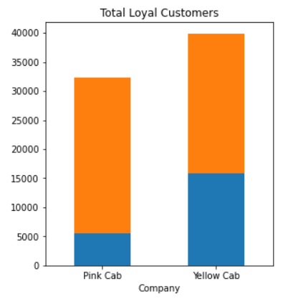
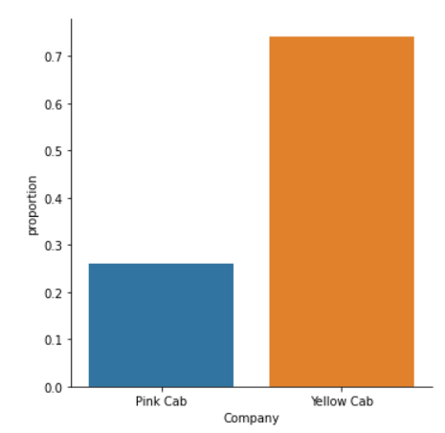
Customer Loyalty/Regular Users Analysis
5 rides
Notes:
Customers who took cab at least 5 times

Slide 32
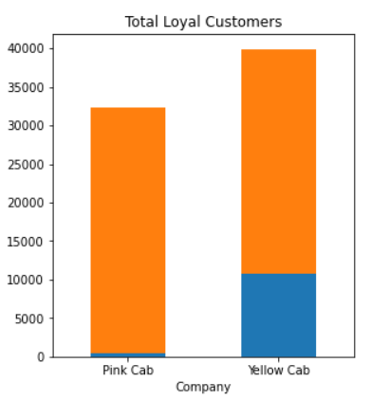
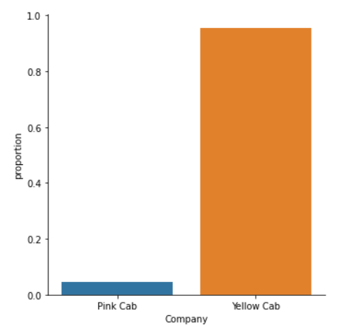
Customer Loyalty/Regular Users Analysis
10 rides
Notes:
Customers who took cab at least 10 times

Slide 33
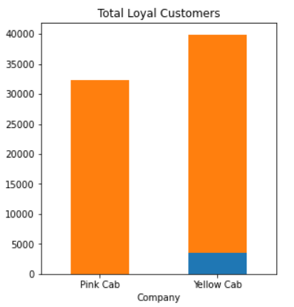
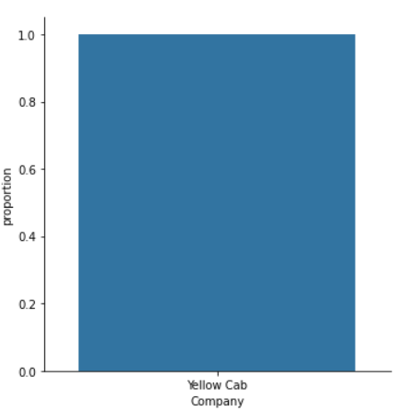
Customer Loyalty/Regular Users Analysis
20 rides
Notes:
It can be clearly seen that yellow cab has more loyal customers (of all type) who use their cab multiple times.
All the highest loyalty customer who use the cab 20 times or more belong to yellow cab and this shows a clear preference by the regular users for yellow cab.

Slide 34


EDA Summary - Insights
Upper Middle Class
New York
December
26-39
Month with most transactions
Age Group with most transactions
Income Group with the most transactions
City with the most Transactions & Profits

Slide 35
EDA Summary – Pink vs Yellow Cab
Yellow Cab
Yellow Cab
Yellow Cab
Yellow Cab
Customer Demand
Customer Loyalty
Company Profits
Service
Notes:
Customer Demand: Yellow cab has higher customer reach in 25 cities while Pink cab has higher customer reach in 4 cities.
Customer Loyalty: Yellow cab is doing far better than Pink cab in retaining customers.
Company Profits: Yellow cab is doing better than Pink cab in all the cities when it comes to profits. They have more profits even in the cities with Pink cab majority.

Slide 36
We recommend XYZ company to invest in Yellow Cab.
We recommend to Invest before the winter season so XYZ company can reap the high profitability months immediately afterwards and therefore do not encounter cashflow problems.
Recommendations
The favorite areas to invest for reaping the highest profits are New York NY and Washington DC.
Although Chicago is profitable for Yellow Cab, we recommend that the high number of losses be dealt by doing further research which may require the pricing model to be changed in the city.

Slide 37
Thank You!
Notes:
Thank you for your time. If you have any questions, please feel free to ask.

